Slide 1
Lecture 16 Bipartite Matching

Slide 2
Motivation: Classroom Assignment
There are n courses and m classrooms.
Because of different requirements (capacity, facility, location etc.) each course can only use a subset of classrooms.
For each course, we are given the list of classrooms that it can use.
Goal: Find a way to schedule all courses in the classrooms. (each course only need one classroom, and each classroom can only hold one course)

Slide 3
Modeling as a graph problem
Edge (i, j): Course i can be scheduled into classroom j
Courses
Classrooms
Solution: A set of edges that do not share any vertices. (a matching)

Slide 4
Maximum Bipartite Matching
Given a bipartite graph with n vertices on one part, and m vertices on the other part,
Goal: Find a maximum matching in the graph.
Bipartite Graph ⬄ Courses and classrooms
Edge (i, j) ⬄ Course i can use classroom j
Matching ⬄ An assignment of courses to classrooms
Maximum matching ⬄ Schedule max # of courses

Slide 5
First attempt: Greedy algorithm
For each course, if it has a classroom that is not taken by any other course, schedule the course in that classroom.
(Simple) Greedy does not work!

Slide 6
Trying to fix the problem
How can we fix this problem?
Idea: If a classroom is taken, ask its instructor to move to another room.
Could you find another room? If yes, then things are fixed.
Carlo, 230
A
Rong, 330
B

Slide 7
Things might become more complicated…
A
B
C
D
D: A, can you find another room? A: let me try…
A: B, can you find another room? B: let me try…
B: C, can you find another room? C: Yes sure.
B ➔ A: I’ve found another room!
A ➔ D: I’ve found another room!

Slide 8
Formalizing the “room exchange” idea
Augmenting Path: An augmenting path is a path from an unmatched course to an unmatched classroom, that alternates between unmatched edges and matched edges.
Path (C, 2), (2, B), (B, 3) is an augmenting path.
A
1
B
2
C
3

Slide 9
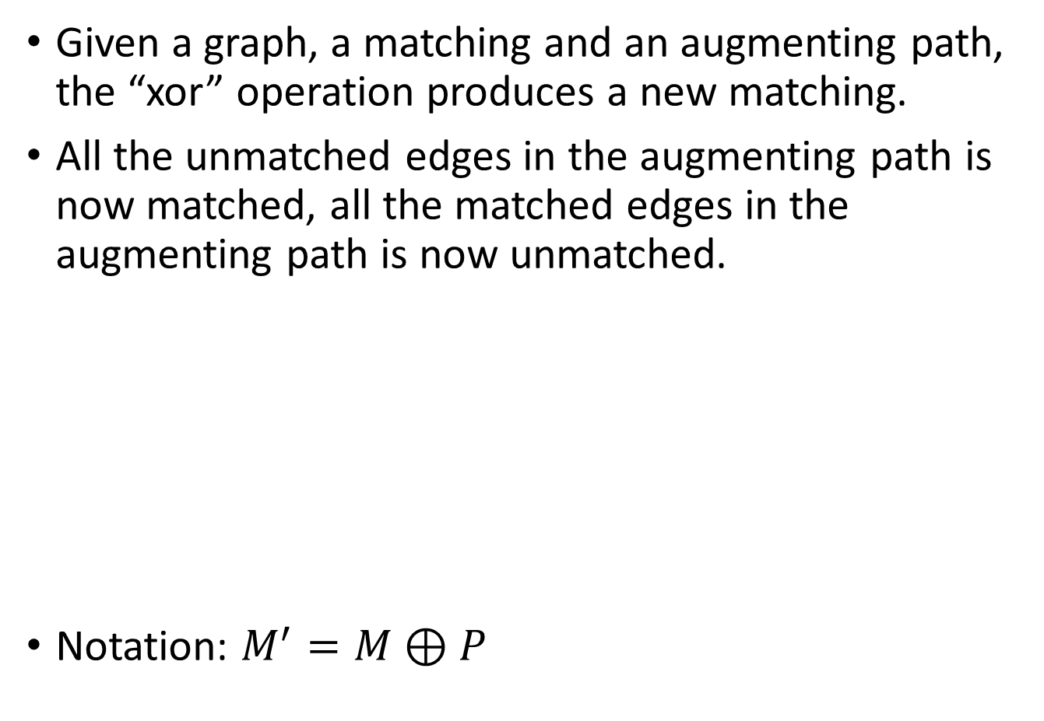
“Xor” Operation
Given a graph, a matching and an augmenting path, the “xor” operation produces a new matching.
All the unmatched edges in the augmenting path is now matched, all the matched edges in the augmenting path is now unmatched.
Notation: $M^{′}=M⊕P$

Slide 10
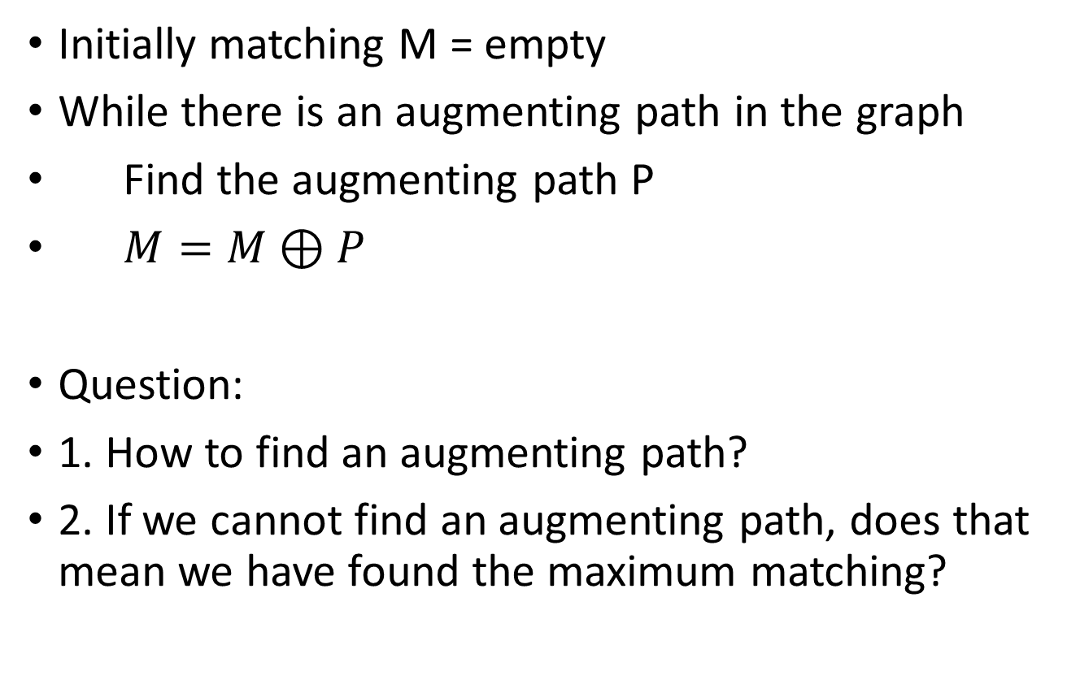
Augmenting Path Algorithm
Initially matching M = empty
While there is an augmenting path in the graph
Find the augmenting path P
$M=M⊕P$
Question:
1. How to find an augmenting path?
2. If we cannot find an augmenting path, does that mean we have found the maximum matching?

Slide 11
Finding an augmenting path
Start from an unmatched course.
If we are at a course vertex, we need to follow an unmatched edge (to get to a classroom).
If we are at a classroom vertex,
If it is not matched, we are done!
If it is matched, we need to follow the (only) matched edge
Can use DFS (or BFS) to do this.

Slide 12
Correctness of the algorithm
Theorem: Given a bipartite graph G and a matching M, is there is no augmenting path with respect to this matching M, then M is a maximum matching.

Slide 13
Implementing the algorithm
Find_Path(u)
Mark u as visited
FOR all edges (u,v) //enumerate over classrooms that course u can use
IF v is not visited THEN IF v is unmatched or Find_Path(match_room[v]) = true THEN
// (if either we found an empty classroom, or the current instructor of // the classroom is able to switch to another room)
match_course[u] = v
match_course[v] = u
// I will take this room
RETURN true // I have found a room for course u.
RETURN false // I’ve tried all the possible rooms, they are not empty and their instructors // cannot switch to another room, so I cannot find a room for course u.
Max_Matching
Initially set all nodes to be unmatched.
FOR u = 1 to n //enumerate the courses
Mark all vertices as unvisited //initialize for the DFS
Find_Path(u) //Try to schedule course u.

